Slide 1
KOLKATA CITY HELP
Presented by:- TEAM Supernova
nsti(w), kolkata

Slide 2
AGENDA
Problem statement
Project overview
Who are the end users
Your solution and its value proposition
The wow in our solution
Modelling
Result
To provide a single window access to the information and services specifically for a city(Kolkata).

Slide 3
PROBLEM STATEMENT
There is no single website that can be rendered by tourists and outstation students for a particular city (Kolkata).
This not only takes a lot of the users' time but also create confusion among them.

Slide 4
PROJECT OVERVIEW
The website has 4 pages.
The first page is the Main page or Homepage. It is the page which is viewed at first by the users. This page has all the necessary introductory details and has been linked to the other pages.
The second page is entirely allotted for tourists and thus has information they should be aware of such as -a map for navigation, Places to visit, hospitals nearby, Police and help in case of an Emergency and authentic food in Kolkata.
The third page is entirely for students and consist of details like type of services required by students such as tuitions, Part time job, PG, Food -Delivery .
The last page is About Us. This page consists about our approach and this website. This page also holds the details of our team members who have worked together to make this website come into existence.

Slide 5

WHO ARE THE END USERS?
The end users are tourists and outstation students .

Slide 6
YOUR SOLUTION AND ITS VALUE PROPOSITION
Your solution and its value proposition Having a user friendly website and a single interface which lists various services making it “one stop solution ” moreover a 'user friendly 'website will not only help people explore Kolkata in a better manner but will also encourage more people to visit the city.
We have also created a chatbot in our website for better user experience. Users will now have a virtual assistant to help them explore our website.

Slide 7

THE WOW IN YOUR SOLUTION
"One stop solution " will be convenient ,effective, efficient and reliable.

Slide 8
MODELLING
Home Page
For Tourist
1. Map, 2.Hospital, 3.Hotels, 4.Tourist places
5.Kolkata Food, 6.Police & Help
For Students
1.PG, 2.Tution, 3.Food Delivery, 4.Internship & Part-time Job

Slide 9
RESULT

Slide 10
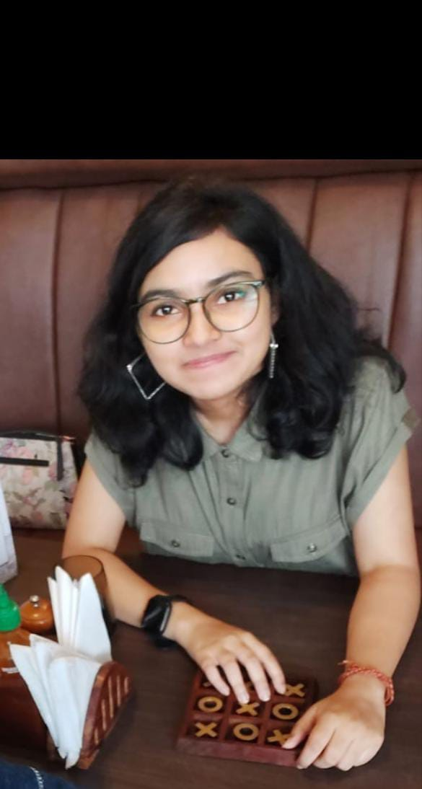
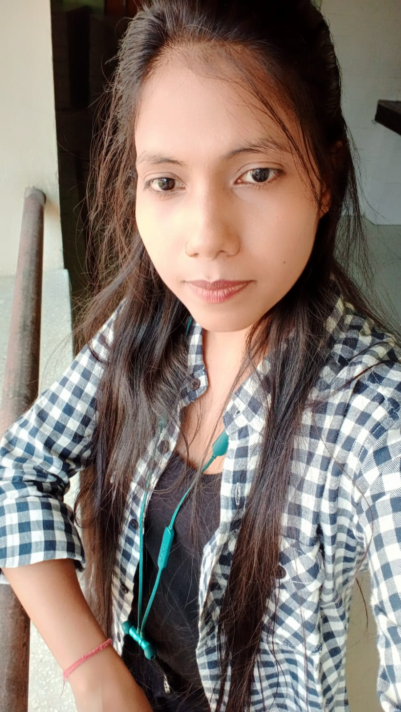
MEET OUR TEAM
Anoushka Das
Susma Kumari Singh

Slide 11
THANK YOU

